Slide 1
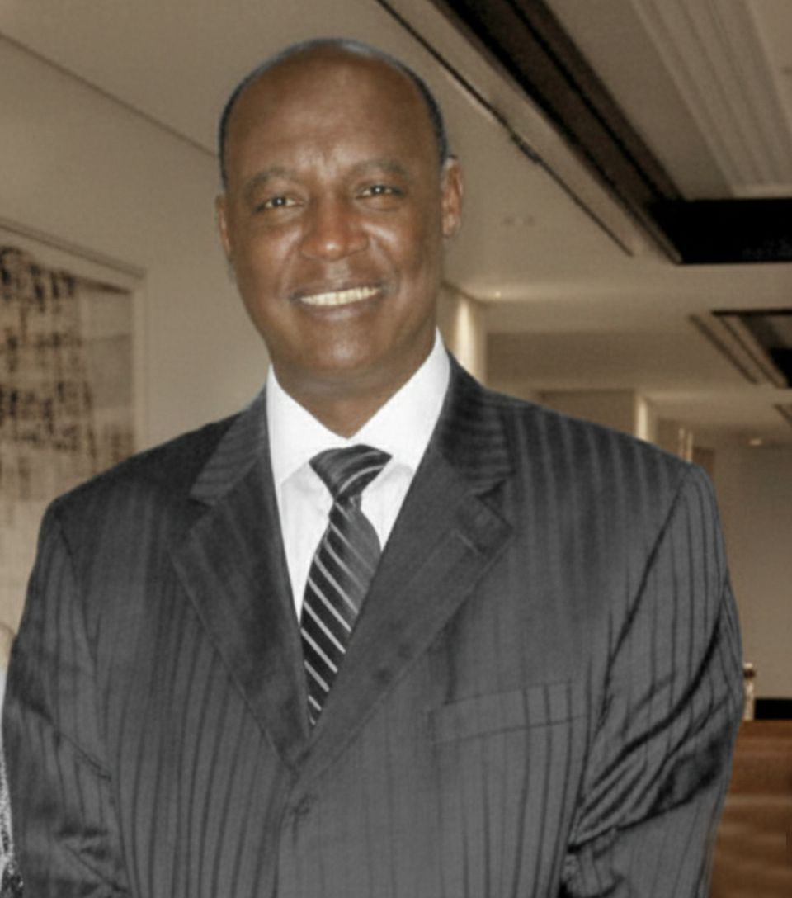
Ambassador
Dr. Mengistu Hulluka
A brief biography of a remarkable life dedicated to education, public service, and national heritage.

Slide 2
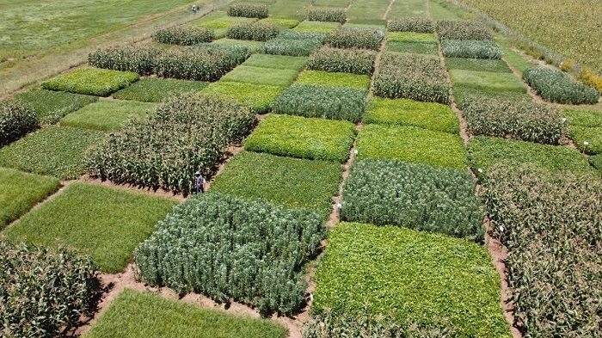
Early Life & Academic Brilliance
Born in Addis Ababa, Dr. Mengistu Hulluka defied initial expectations to pursue a formal education. He began at Kedamawi Haile Silase (Currently Kokebe Tsibah high) Elementary School, quickly distinguishing himself as a top student.
His academic excellence led him to Jimma Technical High School, a collaboration with Oklahoma State University, and later to Alemaya College for Plant Sciences.

Slide 3
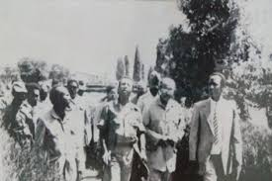
Higher Education Journey
1963
1
Joined Alemaya College to study Plant Sciences.
2
1966
MSc in Plant Pathology from the University of Minnesota, St. Paul.
1972
3
PhD in Plant Pathology (minor in Forestry) from the University of Nebraska, Lincoln.
4
1986
Sabbatical at Texas A&M University, College Station.

Slide 4
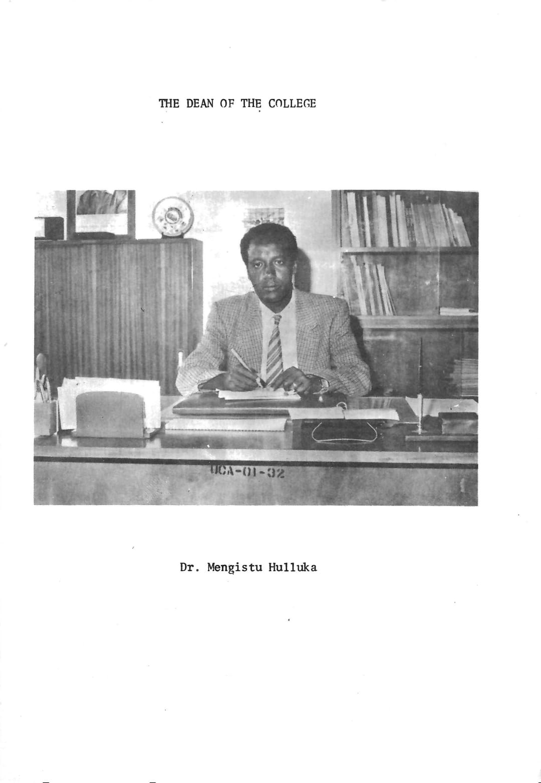
Leadership at Alemaya College
1978
Assistant Dean, College of Agriculture.
1981–1985
1993
Dean, College of Agriculture, demonstrating strong academic leadership.
Vice President for Academic Affairs, Alemaya University of Agriculture.

Slide 5
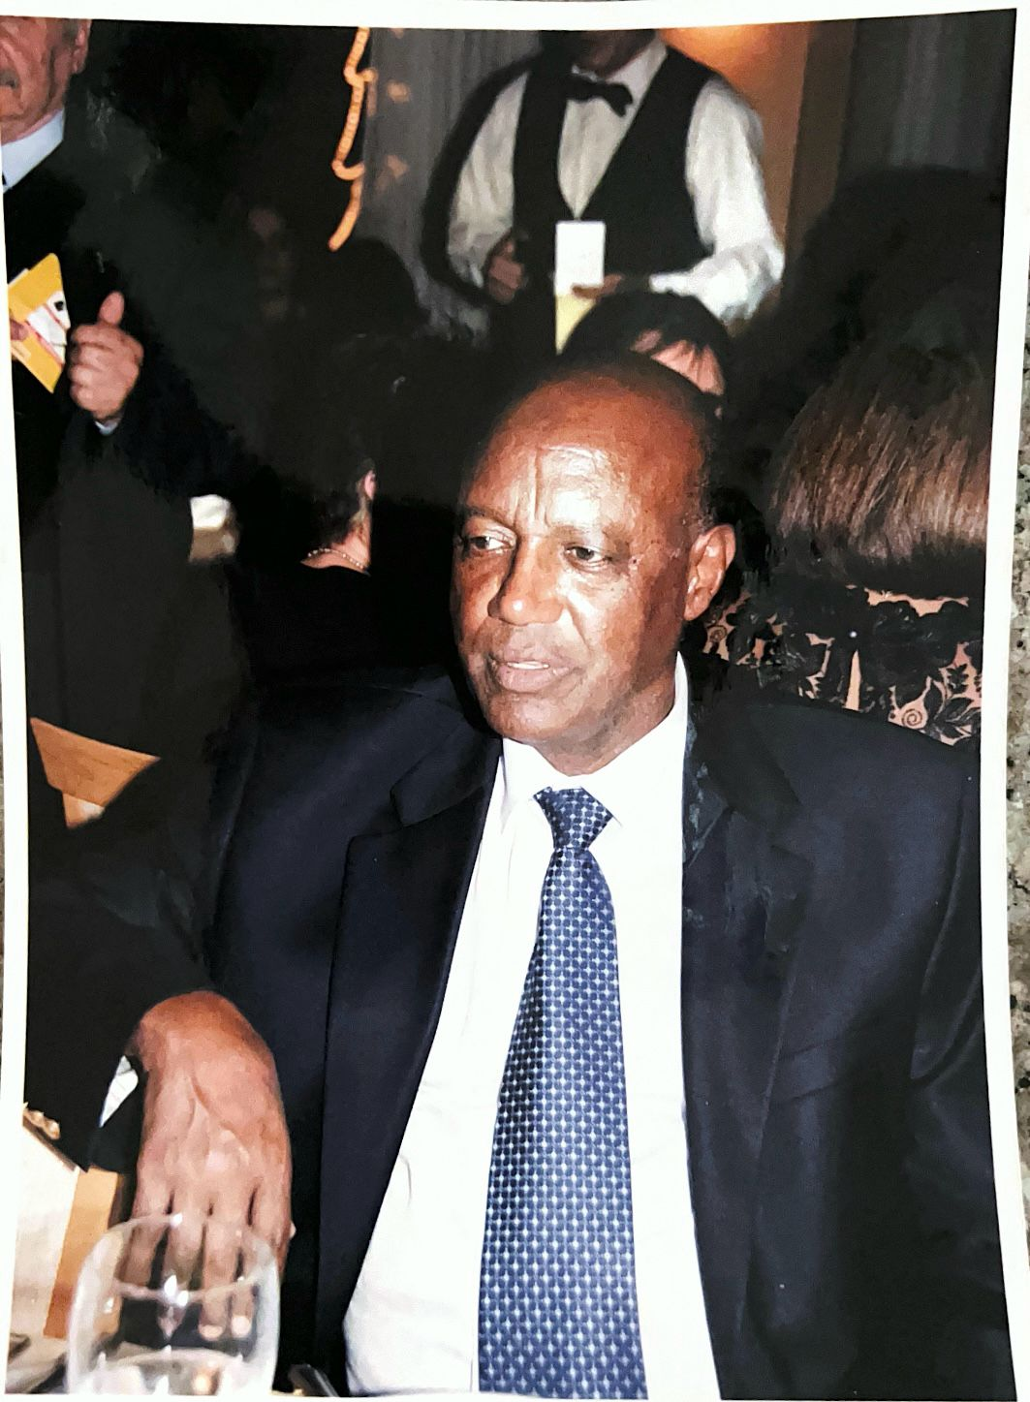
National Contributions
1
1998: Advisor of Higher Education
Shaping the future of national education policies.
2
1998: Minister of Agriculture
Leading agricultural development and policy at a national level.

Slide 6
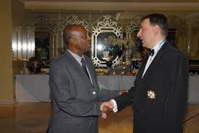

International Representation
2002
Ambassador to Italy,
strengthening diplomatic ties.
2006
Ambassador to Greece,
representing Ethiopia on the global stage.

Slide 7


A Legacy of Mentorship
After retiring from public service in 2009/2010,
Dr. Mengistu continued to inspire and guide the next generation.
Graduate Students
Research & Dissertations
Mentored numerous graduate students, sharing his vast knowledge.
Provided invaluable advice on academic research and doctoral dissertations.

Slide 8
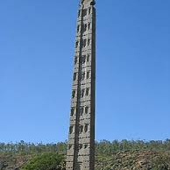
The Aksum Obelisk: A Triumphant Return
One of Dr. Mengistu's most significant achievements was his pivotal role in the return of the Aksum Obelisk to Ethiopia.
This monumental effort symbolized the reclamation of national heritage and cultural pride.
His dedication ensured this ancient treasure was restored to its rightful home, a testament to his commitment to Ethiopia.

Slide 9










Character & Values
Patience
Humility
Integrity
Selflessness
Wisdom
Dr. Mengistu is widely recognized for his exemplary personal qualities, influencing all who knew him.

Slide 10


Enduring Legacy
Dr. Mengistu Hulluka's impact resonates across generations and institutions.
Students: "A mentor, leader, and enduring influence."
Children: "A source of emotional support, wisdom, honesty, and hard work."
Spouse: "Dedication, patience, and responsibility.
Nation: "Cultivating generations, instilling values, and promoting respect."

Slide 11
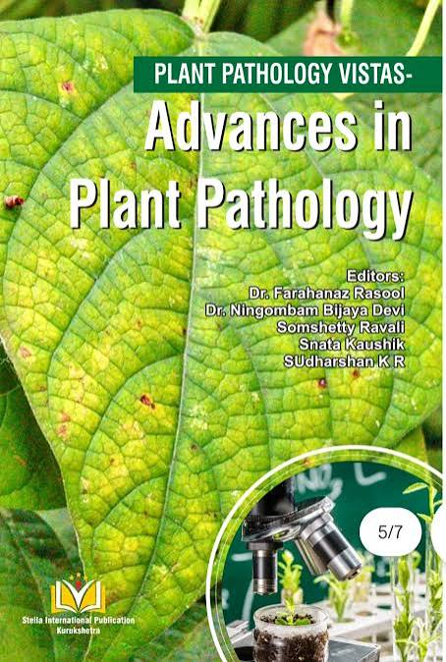
A Living Legend
in Plant Pathology
Dr. Mengistu Hulluka
Innovations in Disease Resistance
  Groundbreaking research led to new strategies for disease resistance in plants, improving crop protection and yields.
Mentorship and Collaboration
  Mentoring and global teamwork have inspired and generated scientists, fostering national and international efforts in plant pathology.
Advancing Sustainable Agriculture
  Promoting sustainable agriculture and food security by applying research findings to real-world farming practices Pre and Post Harvest.

